Slide 1





React
Olmo de Corral Signum Framework Developer #olmocc olmo@signumsoftware.com
www.signumsoftware.com
www.signumframework.com
www.controlexpert.com

Slide 2







A little bit of (my) History
Logic C# SQL
Logic C# SQL
Logic C# SQL
Entities C# WCF
Templates CSHTML
Entities C#/JSON
Views XAML
Views ??
HTML
FORM DATA
Scripts JavaScript jQuery
Scripts TypeScript
Scripts C#
TypeScript

Slide 3

Searching for a JS Framework

Slide 4
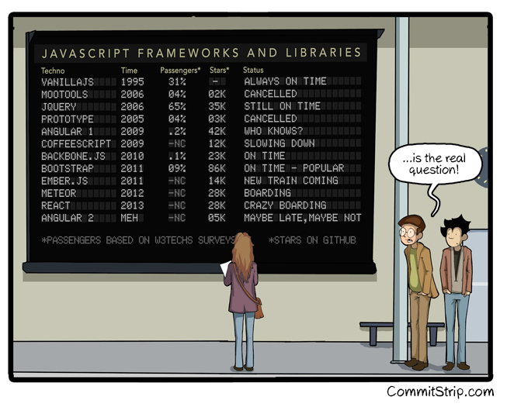
Searching for a JS Framework

Slide 5









Searching for a JS Framework
Model View Controller
Just Render Components™
Reactive
Whatever

Slide 6
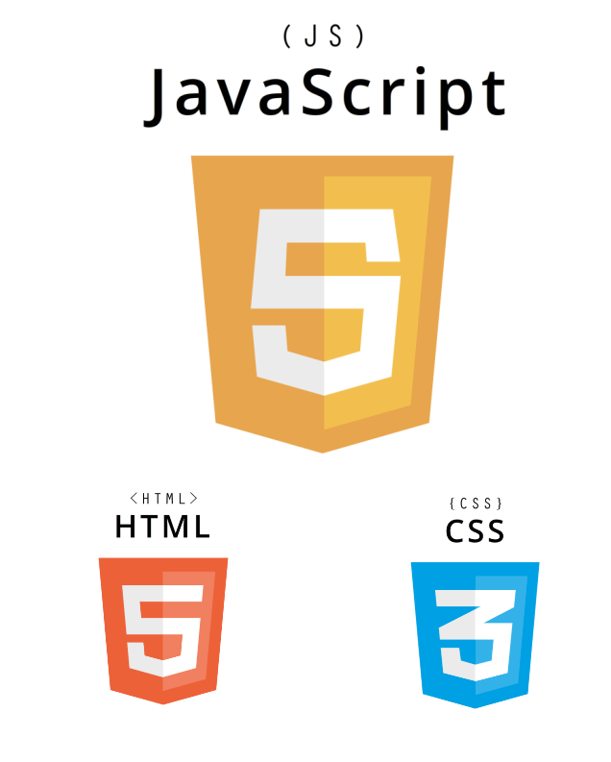

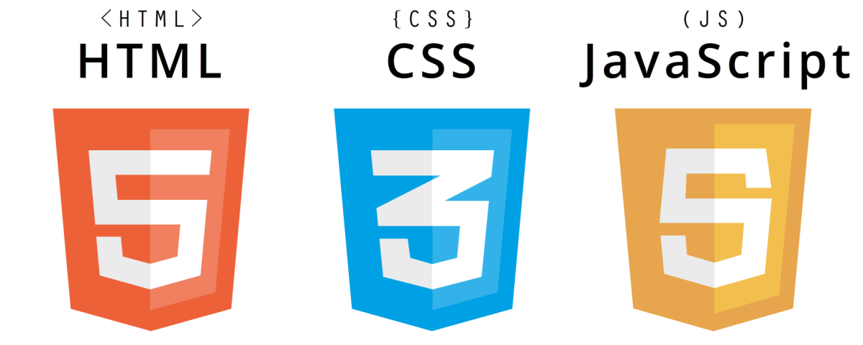
The Web

Slide 7
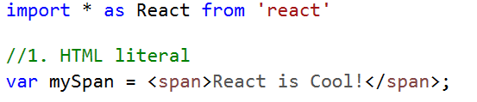
JSX Basics

Slide 8
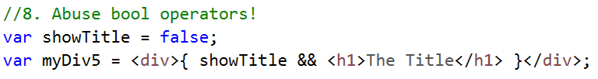
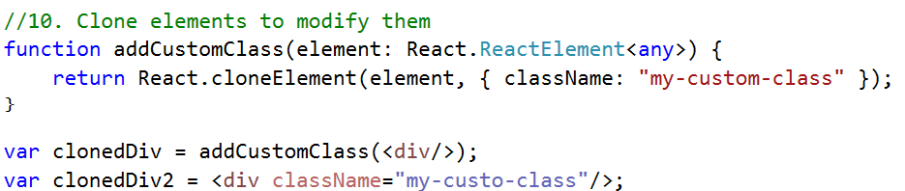
JSX Advanced

Slide 9
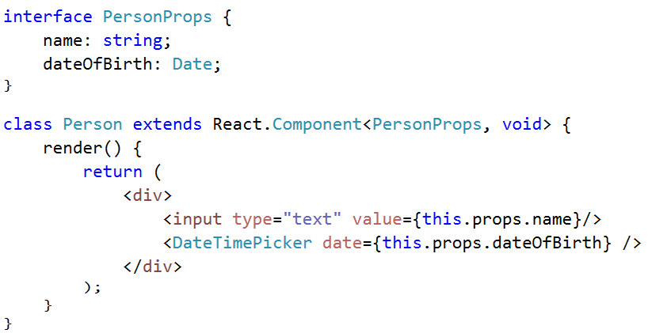
Custom Components
Intrinsic HTML Elements
React Components
In lowercase
In Uppercase

Slide 10
Two-Way Databinding
PersonControl
Person
InputControl
Name: “John”
Value: “John”
OnChange
DateOfBirth: 1984-10-13
DateTimePicker
SelectedDate: 1984-10-13

Slide 11
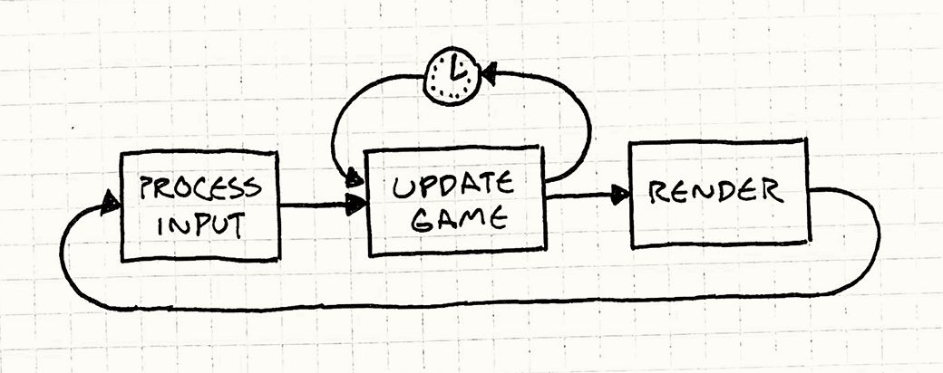
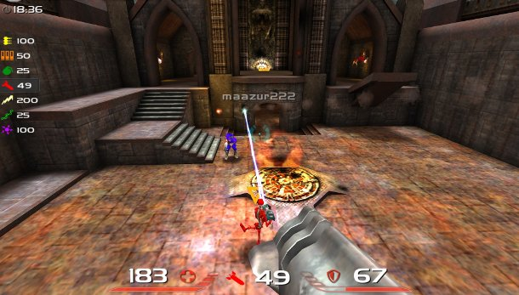
Unidirectional Data Flow
PersonControl
OnChange
Person
InputControl
Name: “John”
Value: “John”
DateOfBirth: 1984-10-13
Render
DateTimePicker
SelectedDate: 1984-10-13
OnChange

Slide 12
DEMO 1: Person Component
Handling Events
Be careful with this!
ForceUpdate

Slide 13
Props vs State
Props
State
Public
Read-only
Recommended
Private
Modifiable
Only if needed
(a.k.a. Parameters)

Slide 14
DEMO 2: DateTimePicker
Props vs State
SetState

Slide 15
Virtual DOM
Person Control
Batch Changes
div
Person Control
div
render()
Diff Algorithm
input
div
div
input
DateTimePicker
input
DateTimePicker
div
input
button
ul
input
button
ul
li
li
li
li
render()
Virtual DOM
Native DOM
FAST (React Elements)
Shallow Tree
Contains:
ReactElement(‘div’)
ReactElement(DateTimePicker)
FAST (javascript objects)
Recursive Tree
Contains:
Instances of React Components and HTML elements
SLOW (layout & render)
Complete Native Tree
Contains:
Real DOM nodes of HTML elements

Slide 16
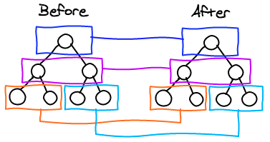
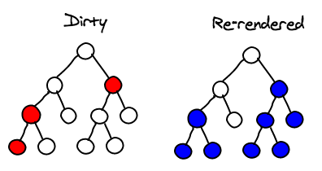
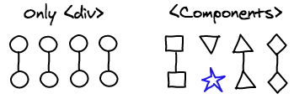
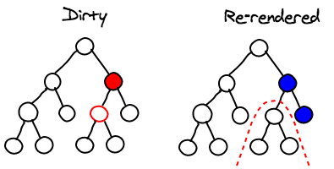
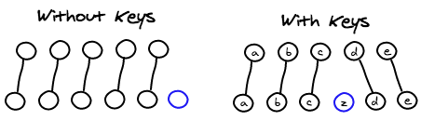
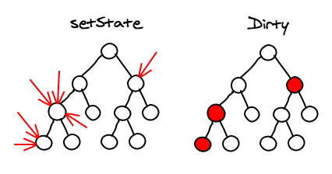
Diff Algorithm Fast and Straightforward
Level by Level
Sub-tree Rendering
Comparing Nodes
shouldComponentUpdate
Comparing Lists
Batching
http://calendar.perfplanet.com/2013/diff/

Slide 17
DEMO 3: React Developer Tools

Slide 18
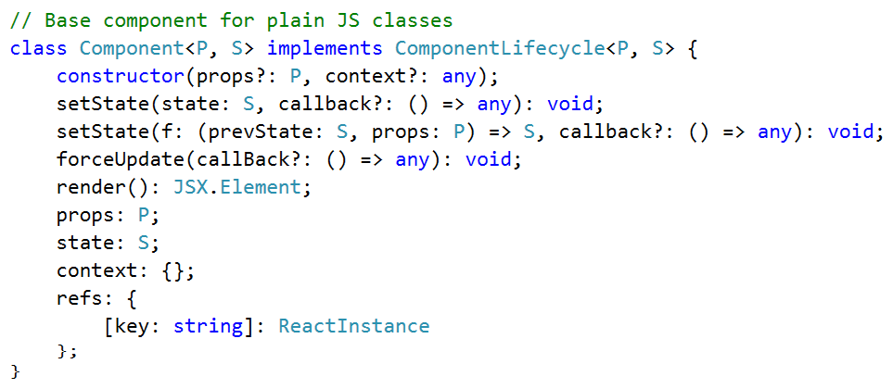
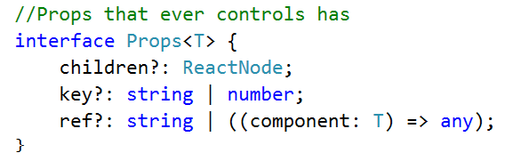
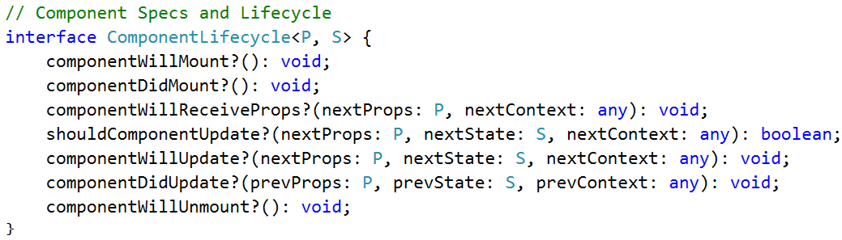
Component API

Slide 19

GRADUATED IN REACT!!!
…but

Slide 20



















Just the V in MVC…
Language
Module System
Build
Bundle
CommonJS (Node)
AMD (Require.js)
UMD
ES6 Modules
elm
CSS Preprocessor
CSS Framework
AtScript

Slide 21
React + Typescript

Slide 22
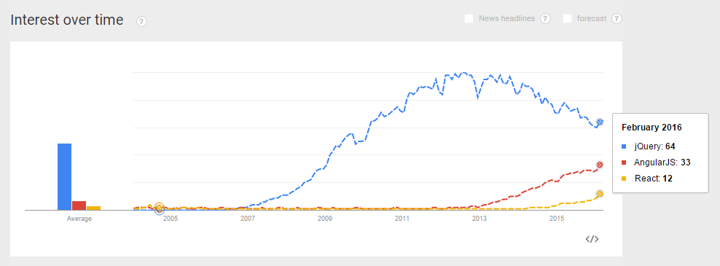
Popular Javascript Frameworks

Slide 23
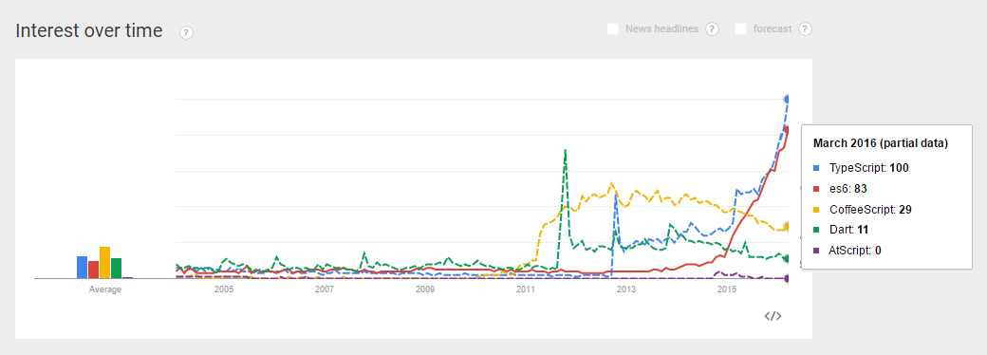
Popular To-Javascript Languages

Slide 24
React + Typescript + Angular

Slide 25
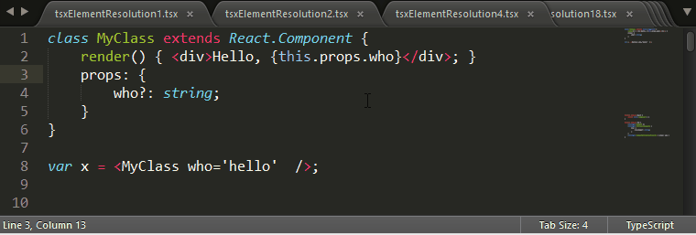







React + Typescript

Slide 26
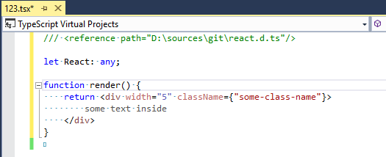
TSX = TS + JSX
Typescript 1.6
Full JSX support
Strongly typed
Props vs State
Spread operator
New as operator for casting
Two outputs: preserve / react
BUG: Formatting Problems
Typescript 1.8
Syntax coloring
Stateless Function Components
Simplified props
Custom JSX Factories
BUG: Auto-completion problems
Flow analysis (return)
Lack of import auto-complete

Slide 27
React Ecosystem (Tested)

Slide 28
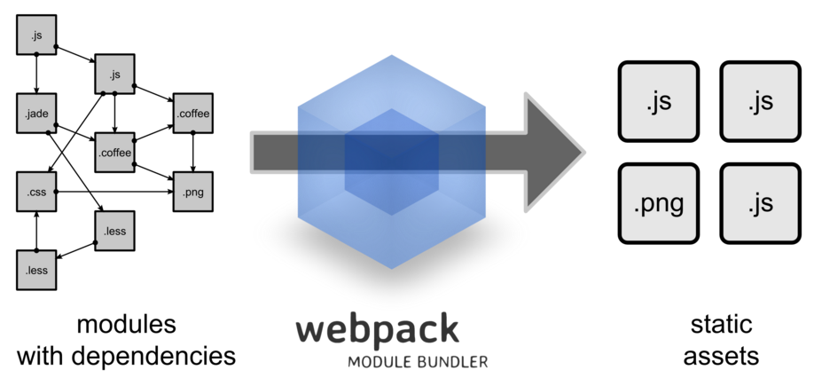
Solves the whole bundling problem
Follows JS require / import
Sync and Async dependencies
Styles, fonts and other assets
Hash & Cache Invalidation
--watch mode
Tricky to configure
Black box
Lots of plugins and loaders
Typescript / Babel / CoffeeScript
CSS / LESS / SASS
Customize bundles
Uglyfx
Notify
WebPack Task Runner for Visual Studio 2015 ... useful?

Slide 29

keeps your UI in sync with the URL
Associates Components with URLs
Using JSX!
Cumbersome API with many breaking changes
History repository needed?
Incomplete Typescript definition files (.d.ts)
https://github.com/reactjs/react-router

Slide 30

React-Bootstrap
The most popular front-end framework, rebuilt for React.
Good documentation
Very Complete (Modals, Tabs, Tooltips)
Too much? (Button, MenuItem)
Overlays repository need?
Incomplete Typescript definition files (.d.ts)
https://react-bootstrap.github.io/

Slide 31
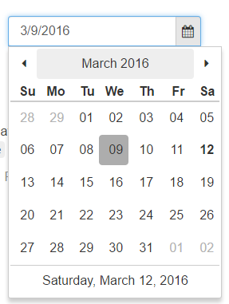
React Widgets
offers a set of html form inputs, built from scratch with React
Good documentation
High quality components
Dropdown / Combobox
Date-Time picker
No definition files (I built my own)
https://jquense.github.io/react-widgets/docs

Slide 32
React Ecosystem (Untested)

Slide 33



Server-Side Rendering
Person
div
div
Batch Changes
input
div
✓
input
DateTimePicker
?
div
input
button
ul
Browser
input
ul
li
li
button
li
li
Person
<div>
<input/>
<div>
<input/>
<button/>
/div>
</div>
div
Generate HTML String
input
DateTimePicker
div
Server
input
button

Slide 34

ReactJS.NET makes it easier to use Facebook's React and JSX from C# and other .NET languages, focusing specifically on ASP.NET MVC (although it also works in other environments).
On-the-fly JSX to JavaScript compilation
JSX to JavaScript compilation via popular minification/combination libraries
Server-side component rendering
Typescript support?
<script src="@Url.Content("~/Scripts/HelloWorld.jsx")"></script>
bundles.Add(new JsxBundle("~/bundles/main").Include("~/Scripts/HelloWorld.jsx"))
@Html.React("CommentsBox", new { initialComments = Model.Comments })

Slide 35

React Hot Loader will keep it mounted, preserving the state.
http://gaearon.github.io/react-hot-loader/
Works on IIS?

Slide 36

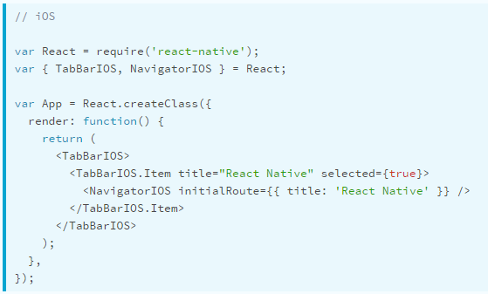
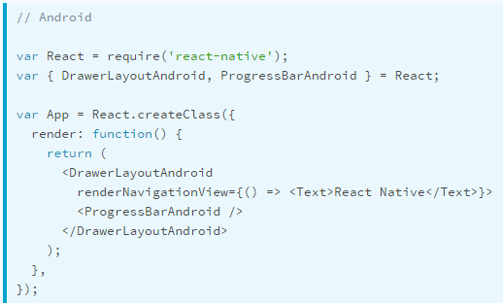
React Native
A FRAMEWORK FOR BUILDING NATIVE APPS USING REACT
Native Components
Asynchronous Execution
Touch Handling
Flexbox and Styling
Extensibility

Slide 37
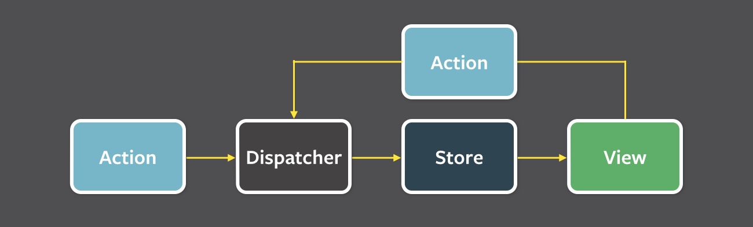








Flux Implementations
Reflux
Materil Flux
Fluxette
Freezer
Fluxury
Fluxy
Flummox
Marty.js
McFly
Delorean
Lux

Slide 38
Signum.React

Slide 39
Signum Framework UIs
Logic C# SQL
Logic C# SQL
Logic C# SQL
Entities C# WCF
Templates CSHTML
Entities C#/JSON
Views XAML
Views TSX
HTML
FORM DATA
Scripts JavaScript jQuery
Scripts TypeScript
Scripts C#
TypeScript

Slide 40


Server-Side
Client-Side
REST - JSON Metadata
Translations
Permissions
Run-Time
Busines Logic
API Contollers
React Components
T4S
Compile-Time
Entities Enums
Messages
…
Code-generation
with templates
Entities Enums
Messages
…

Slide 41
DEMO 4: Signum.React

Slide 42

80% Code Converted
cshtml
Server-Side
Client-Side
Run-Time
Metadata
Translations
Permissions
Busines Logic
API Contollers
React Components
1-Time Code Generation
T4S
Compile-Time
Entities Enums
Messages
…
Code-generation
with templates
Entities Enums
Messages
…

Slide 43
Conclusion
React is Awesome
Simplicity
Expressivity
Performance
… but incomplete
React + Typescript is even better
Compile-time checked
Auto completion
Safe renames
...missing .d.ts
Big Ecosystem
Webpack
React Bootstrap
React Widgets
React Router
You may need server-side solution
Auto-generate definition files from C#
Expose meta-data with reflection
Facilitate migration
React Native
React.Net
React Hot Loader
…

Slide 44
THE END
Olmo de Corral Signum Framework Developer #olmocc olmo@signumsoftware.com
www.signumframework.com
www.signumsoftware.com
www.controlexpert.com

